Slide 1
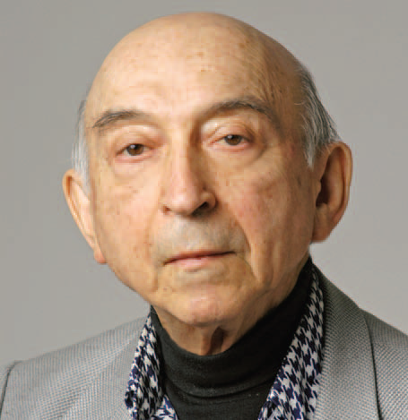
Introducing Professor Lotfi A. Zadeh
Kouros Goodarzi
Chair, IEEE Vancouver Section
PersIT Nov. 18, 2012

Slide 2
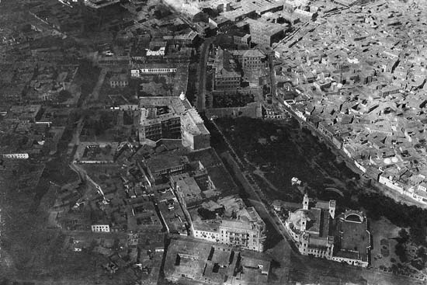
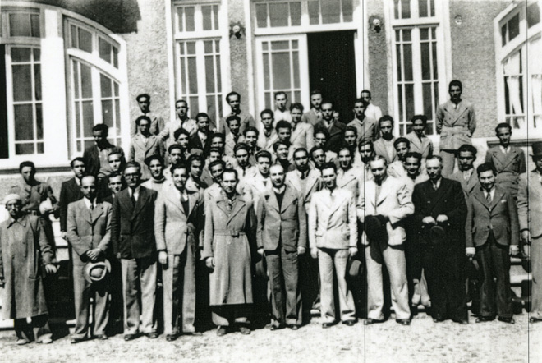
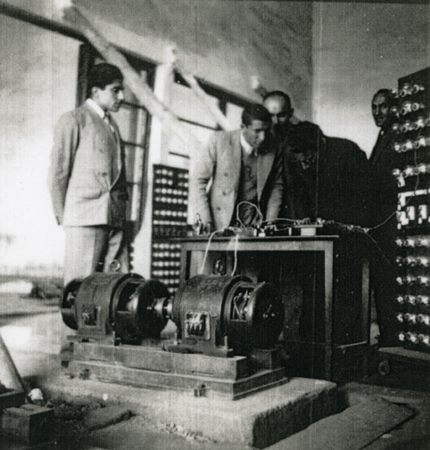
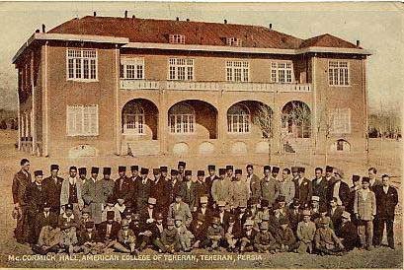
Short Bio
Born in Baku, Feb 4, 1921 (a year after Azerbaijan became a Soviet State)
Moved to Tehran in 1931 and placed in 8th grade (from third) at American School (Alborz)

Slide 3
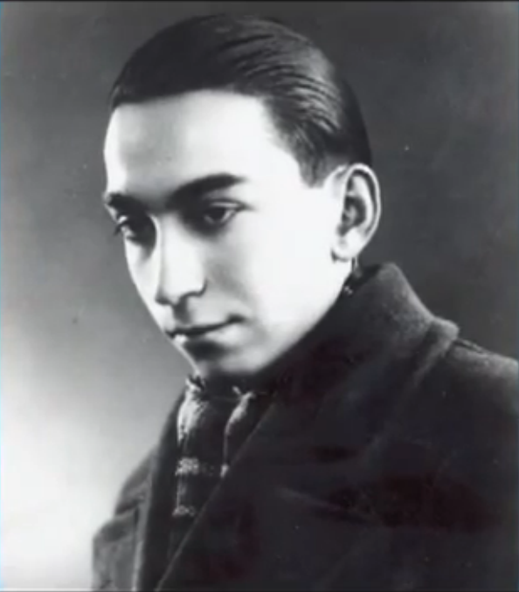
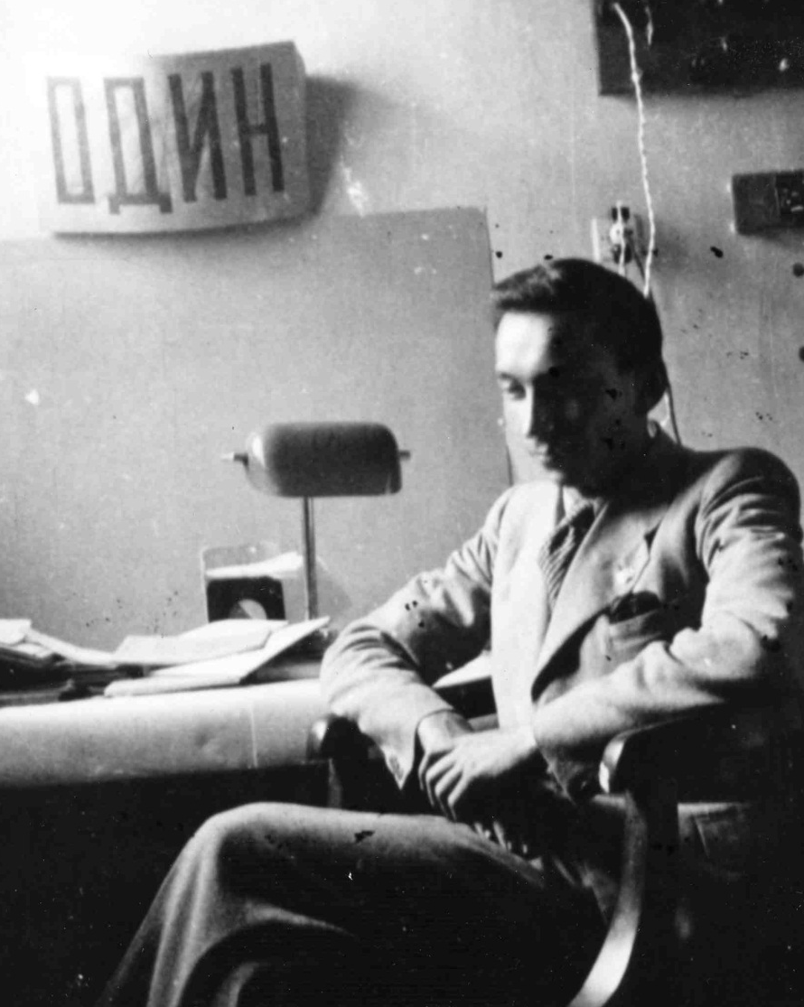
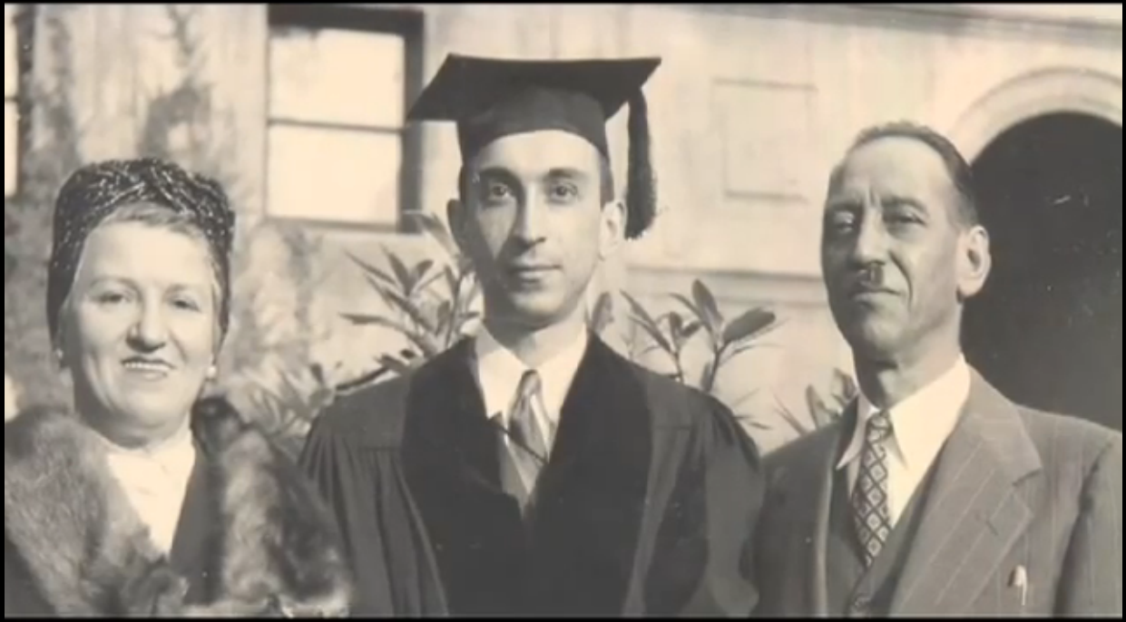
Short Bio – Education
Graduated from Tehran University with a B.Sc. In Electrical Engineering in 1942
Graduate school at MIT, S.M. in Electrical Engineering in 1946
Moved to Columbia, Ph.D. in 1949

Slide 4
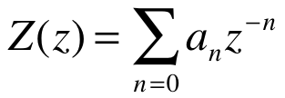
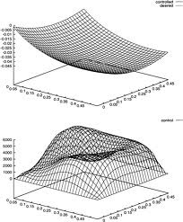
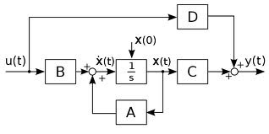
Early Research Focus
Columbia University years 1946-1959
Frequency analysis of time-varying networks
Extension of Wiener’s theory of prediction (with JR Ragazzini)
New approach to analyzing sampled-data systems (leading to the well-known z-transformation)
Early Berkley years 1959-1963
System theory, optimal control, time-varying systems, and system identification
Linear System Theory – State-space approach (with Charles Desoer)

Slide 5
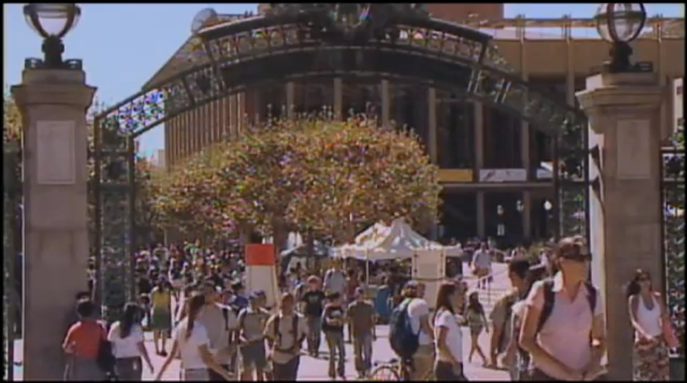
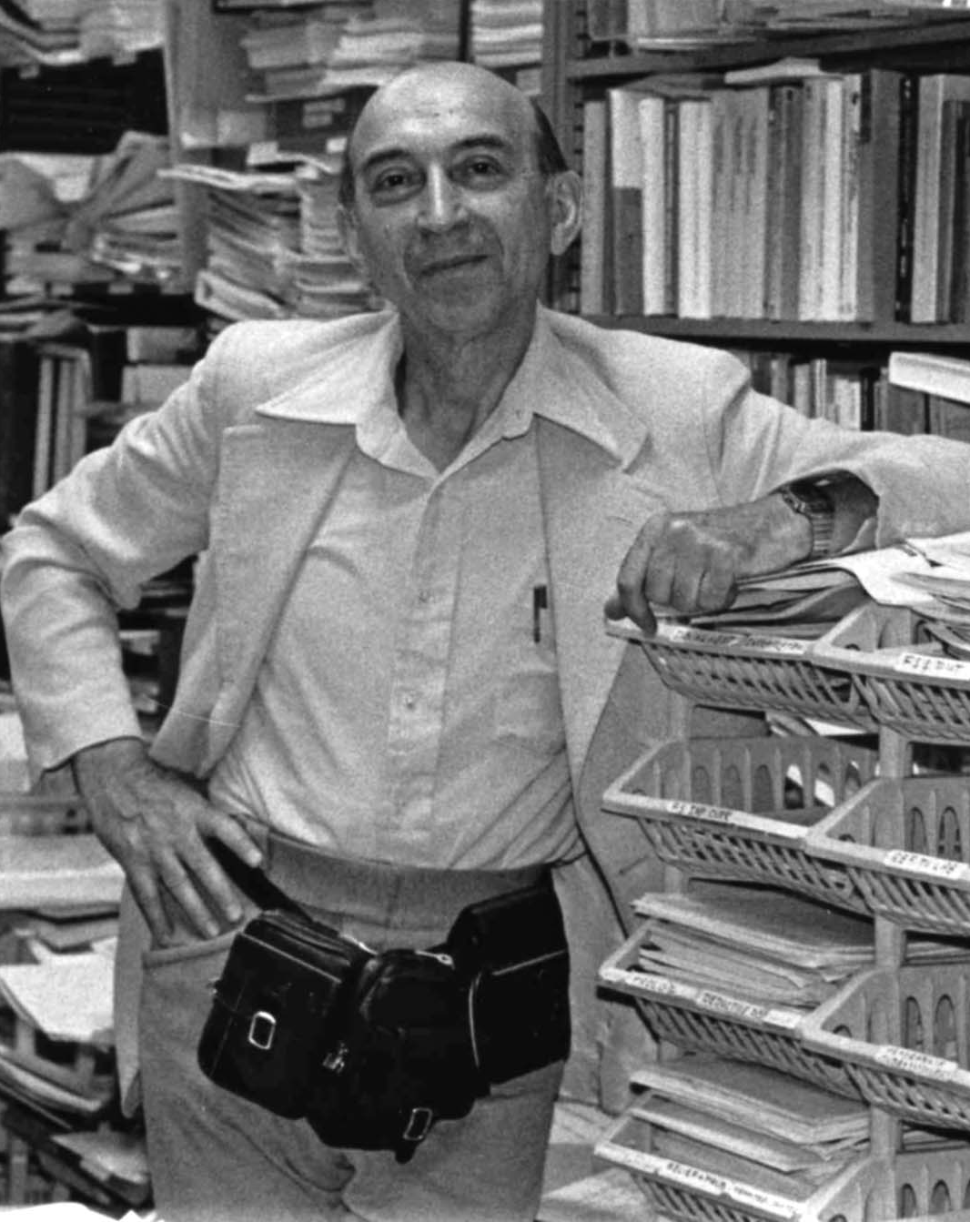
Later Years 1963-Present
Chairman of the department of EE, University of California, Berkley (1963-1968)
Expanded department to include Computer Science
Current Positions (Since 1991)
Professor Emeritus at Berkley
Director of the Berkley Initiative in Soft Computing (BISC)

Slide 6
Teaching & Research
Member of the faculty, Columbia University, 1946–1959
Member of the Faculty, University of California, Berkeley, 1959-present
Visiting Member, Institute for Advance Study, Princeton, New Jersey, 1956
Visiting Professor, MIT, 1963 and 1968.
Visiting Scientist, IBM Research Laboratory, San Jose, CA, 1968, 1971, 1974 and 1977
Visiting Scientist, AI Center, SRI (Stanford Research Institute), CA, 1981
Visiting Scholar, Center for the Study of Languages and Information, Stanford University, 1987

Slide 7
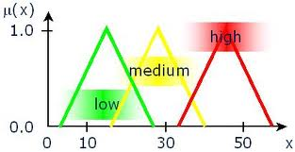
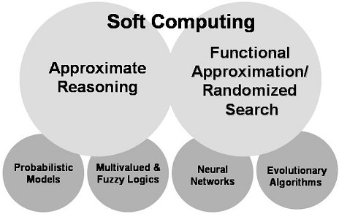
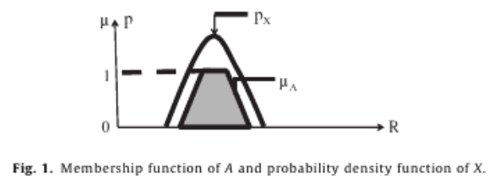
Fields of Interest
Fuzzy Sets, Fuzzy Logic, Linguistic Variables
Soft Computing
Z-Numbers

Slide 8
Memberships & Honors
Member of National Academy of Engineering
Foreign member of the Russian Academy of Natural Sciences
Member of the Finnish Academy of Sciences
Member of the Polish Academy of Sciences
Member of the Korean Academy of Sciences & Technology
Member of the Bulgarian Academy of Sciences
Fellow of IEEE, AAAS, ACM, IFSA, and AAAI
Recipient of 26 honorary Doctrates

Slide 9
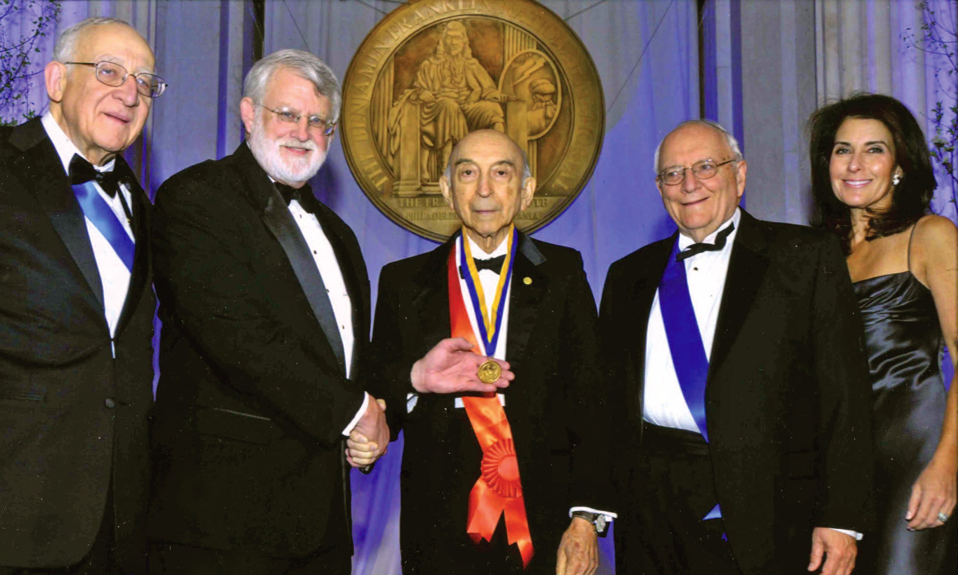
Medals & Awards
Presidential Friendship Medal, Republic of Azerbaijan
Silicon Valley Engineering Hall of Fame
Benjamin Franklin Institute Medal
Nixdorf Museum Wall of Fame
IEEE Richard W. Hamming Medal
ACM Allen Newell Award
V. Kaufmann Prize
Kampe de Feriet Prize
IEEE Education Medal
IEEE Medal of Honor
Grigore Moisil Prize
IEEE SMC Norbert Wiener Award
Copernicus Medal
AI Hall of Fame
Bolzano Medal
Okawa Prize
Honda Prize

Slide 10
IEEE Medals & Awards
IEEE Richard W. Hamming Medal
1992 – “For seminal contributions to information science and systems, including the conceptualization of fuzzy sets.”
IEEE Education Medal
1973 – “For inspired and dedicated teaching, and distinguished leadership in system theory.”
IEEE Medal of Honor
1995 – “For pioneering development of fuzzy logic and its many diverse applications.”
IEEE CS-AI Hall of Fame
2011 – “… known for his work on soft computing, fuzzy logic, and neural-net theory.”

Slide 11
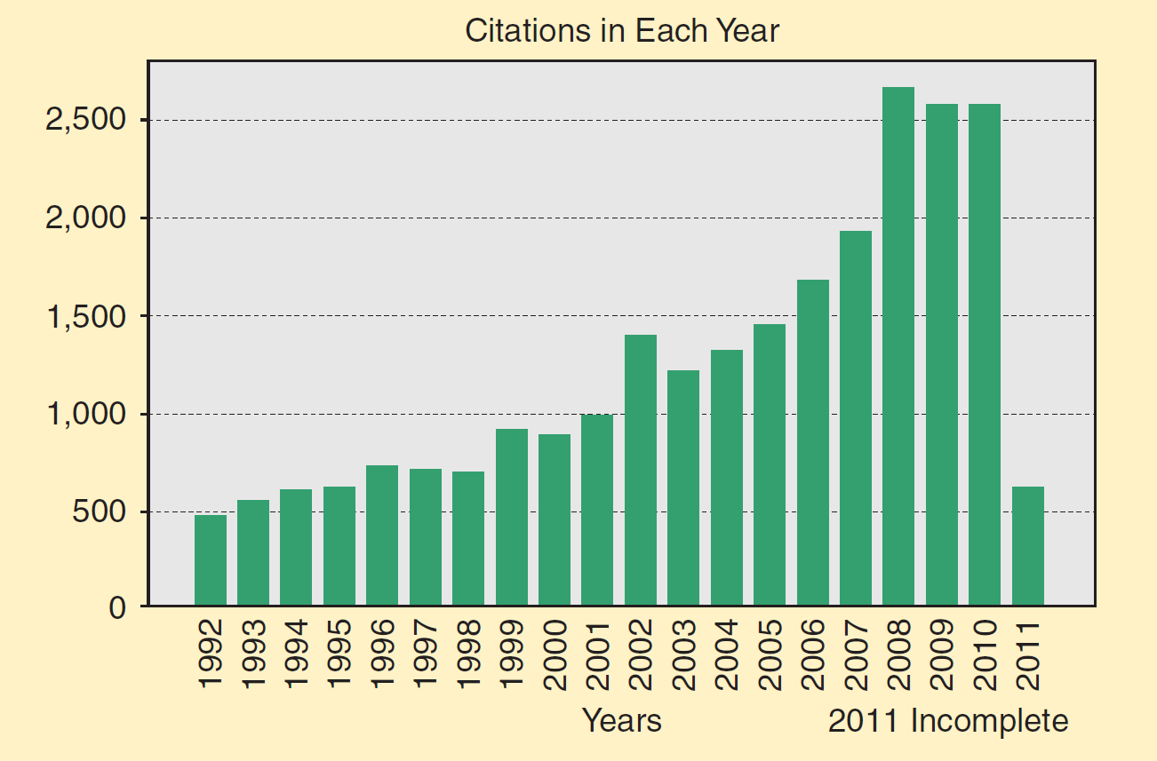
Publications, Citation, & Patents
Publications/citations/patents | Count
Publications containing the word “fuzzy” in the title* | 85,000+
Papers with “fuzzy” in title† | 237,000
Citations of papers by L. Zadeh‡ | 117,925
Citations of L. Zadeh’s 1965 paper “Fuzzy sets”† | 26,088
Fuzzy-logic-related patents in Japan** | 22,541
Fuzzy-logic-related patents in the US | 33,022
Journals on Fuzzy: 24
Journals on Soft Computing: 20
* Cited in INSPEC and MATH.SCI.NET databases. (Compiled on March 29, 2011)
** Estimated number of patents applied for or issued
† Google Scholar
‡ Web of Science & Google Scholar combined

Slide 12
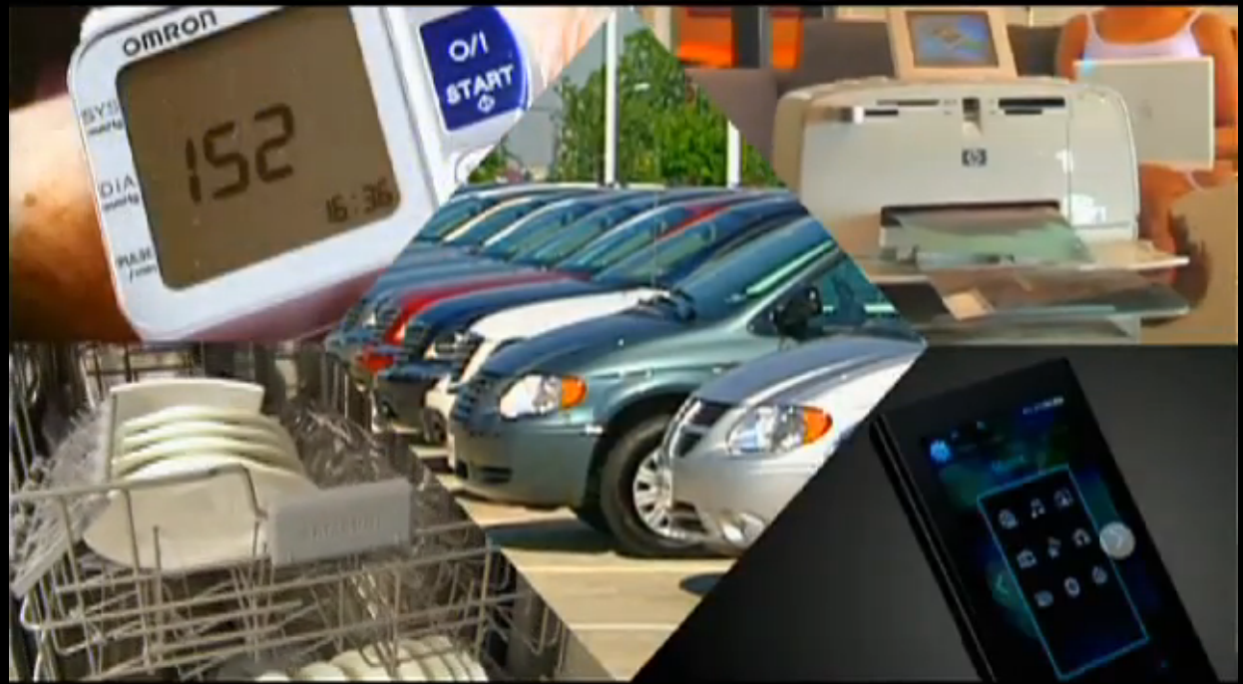
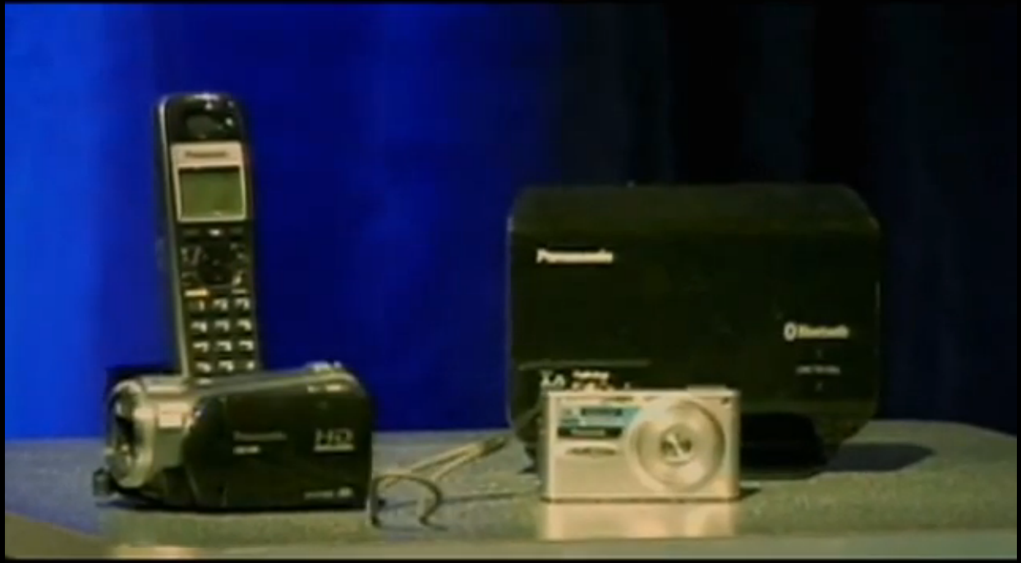
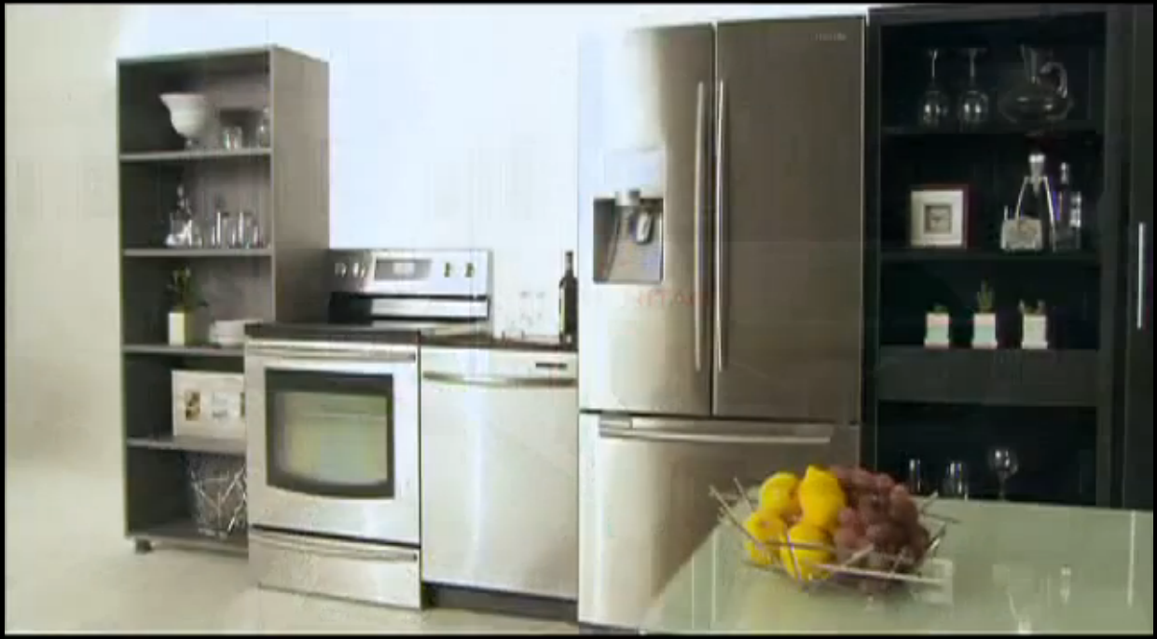
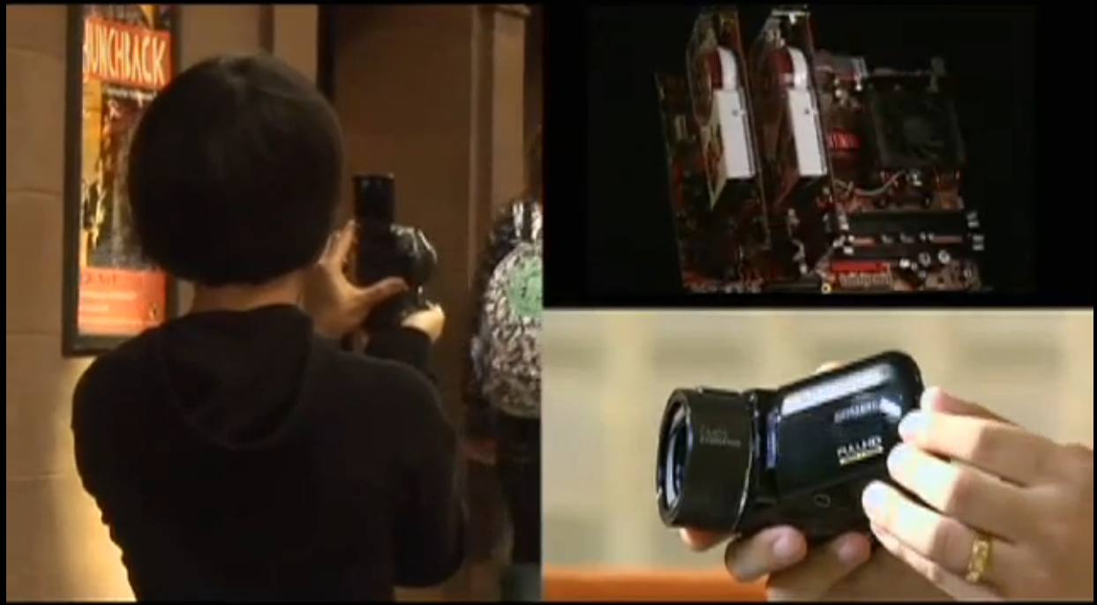
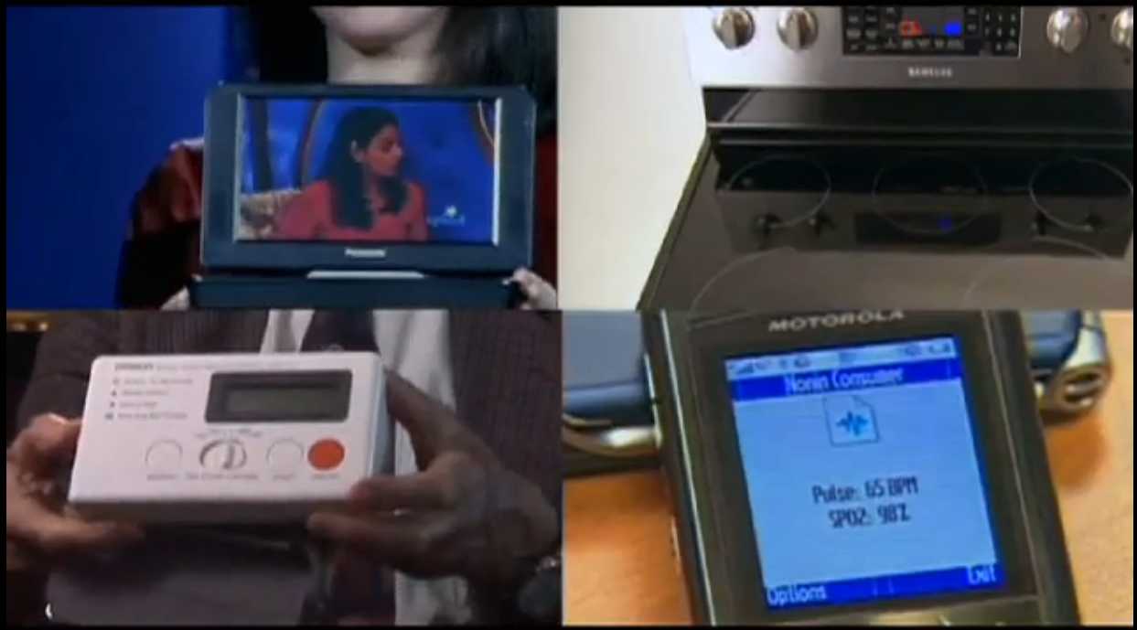
Impact

Slide 13
Quotes
It is a sobering thought that profits and efficiency have become the driving forces that shape the dynamics of our society, and that money may become the ultimate determinant of values by which we live. […] In this climate of media manipulation and commercialism, it is not surprising that our young people have become cynical and materialistic. […] it is our collective responsibility--and especially the responsibility of your generation-the generation that will shape our future--to do whatever can be done in our democratic society to prevent the corrosive forces of commercialism and consumerism from encroaching on our culture and becoming dominant influences in defining our values, our beliefs, and our morals.
Lotfi A. Zadeh - 1997 commencement Address; UC Berkeley
“Lotfi has always treated people with kindness, generosity and respect. […] I never saw him lose his temper or his
focus, and he often responded to the most egregious assaults
by saying ‘I’ll take it as a compliment’.”
James C. Bezdek, University of Melbourne, AUSTRALIA
“When I look over my entire career, I can see Zadeh’s influence on it to degree greater than around 0.7”
Jerry M. Mendel, University of Southern California, USA
“As complexity rises, precise statements lose meaning and meaningful statements lose precision”
Lotfi A. Zadeh, University of California at Berkley, USA

Slide 14
Fuzzy Journals (24)

Slide 15
Soft Computing Journals (20)

Slide 16
References
George Klir & Bo Yuan, editors. Fuzzy Sets, Fuzzy Logic, and Fuzzy Systems: Selected Papers by L. A. Zadeh. World Scientific, Singapore, 1996.
Scholarpedia user page for Dr. Lotfi A. Zadeh
IEEE Global History Network, Oral History: Lotfi Zadeh, 2009
Keynote Biography, 31st Annual NAFIPS Meeting, Berkley, Aug 2012
Articles from Azerbaijan International, Winter 1994 (2.4) Pg 49; Winter 1994 (2.4) Pgs 46-47,50; Spring 1998 (6.1) Pg 65;
2009 Benjamin Franklin Medal Winner: Lotfi A. Zadeh
IEEE Medals, Technical Field Awards, and Recognitions
Interview with Professor Lotfi A. Zadeh, Computational Intelligence Magazine, Nov. 2011, Pgs 13-17
Professor Zadeh’s 1997 Commencement Address at University of Berkley

